Slide 1

Session 9
Cyber Attacks - Attack & Defend Case Study
Human and Technical Failures

Slide 2

Learning Outcomes :
By the end of this session, you will:
Analyze a real-world cyber attack case study involving both human error and technical flaws.
Understand how attackers exploit the combination of social engineering and system vulnerabilities.
Evaluate the timeline of an attack from infiltration to damage.
Examine defense breakdowns and identify missed warning signs.
Propose improvements to organizational cyber defense strategies.

Slide 3

Understand :
What is a Combined Cyber Attack?
Case Study Overview: Attack on a Financial Institution
Role of Human Error in Cyber Attacks
Exploited Technical Vulnerabilities
Response, Damage, and Recovery
Defensive Measures and Lessons Learned

Slide 4
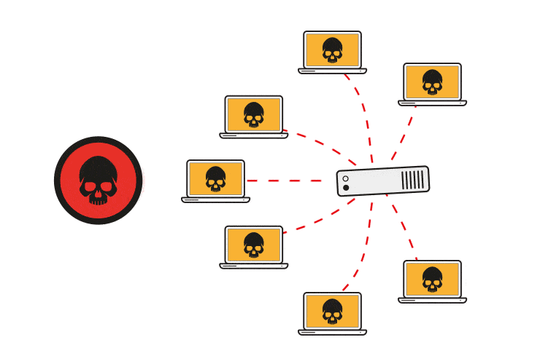
What Is a Combined Cyber Attack?
A combined cyber attack exploits both human behavior and technical weaknesses in an organization.
Key Characteristics:
Initiates through phishing, pretexting, or social engineering.
Escalates by leveraging system flaws, misconfigurations, or outdated software.
Difficult to detect due to the dual nature of infiltration.

Slide 5

Case Study : The FinanceCo Breach
Background:
FinanceCo, a mid-sized financial services company, suffered a breach resulting in data theft and service outages.
Timeline Summary:
Employee received a phishing email from a spoofed HR address.
Credentials were harvested via a fake login portal.
Attackers moved laterally in the network using unpatched systems.
Sensitive client data was exfiltrated over several days.

Slide 6
Case Study : Role of Human Error
Trusting a familiar email sender without verifying authenticity.
Reusing weak or repeated passwords across systems.
Lack of employee training on phishing identification.
Delayed reporting of unusual system activity.

Slide 7
Case Study : Exploited Technical Vulnerabilities
Outdated operating systems with no endpoint protection.
Weak access controls allowed lateral movement.
Lack of network segmentation.
No multi-factor authentication (MFA) on remote access.

Slide 8
Case Study : Impact of the Attack
Client Data Compromised: 40,000+ records, including financial histories.
Operational Downtime: Systems were shut down for 48 hours.
Reputation Loss: Media coverage led to client churn.
Regulatory Fines: Breach of compliance under data protection laws.
Cost of Recovery: Estimated $2.4 million in damages.

Slide 9
Case Study : Defensive Measures & Mitigation
Security Awareness Training: Mandatory for all employees quarterly.
Patch Management: Automate and monitor software updates.
Zero Trust Architecture: Validate all access attempts.
Incident Response Plan: Include escalation paths and forensics.
Simulated Phishing Tests: Regular employee assessments.

Slide 10


PYTHON PRACTICAL ACTIVITY ( Code Link )
Practical Activity # 1 (Phishing Email Simulation and Detection Script)
Practical Activity # 2 (Weak Password Reuse Detection)
Practical Activity # 3 (Lateral Movement Simulation via Network Access)
Practical Activity # 4 (MFA Enforcement Checker)
Practical Activity # 5 (Simulated Red Team vs Blue Team Alert System)

Slide 11
Practical Activity # 1 (Phishing Email Simulation and Detection Script)
🔐 Objective: Simulate a phishing email and detect patterns using basic keyword analysis.
# phishing_simulator.py
suspicious_keywords = ["urgent", "reset your password", "verify your account", "click here", "login", "limited time"]
def is_phishing(email_content):
score = sum(1 for keyword in suspicious_keywords if keyword.lower() in email_content.lower())
return score >= 2
# Simulated input
email = """
Hi, this is from HR. Please reset your password immediately to avoid suspension. Click here to proceed.
"""
print("Email flagged as phishing?" , is_phishing(email))

Slide 12
Practical Activity # 2 (Weak Password Reuse Detection)
🔐 Objective: Detect reused or weak passwords by comparing user inputs against a blacklist and shared usage.
# password_reuse_detector.py
common_passwords = {"123456", "password", "qwerty", "abc123", "letmein"}
def is_weak_or_reused(user_passwords):
unique_passwords = set()
for pw in user_passwords:
if pw in common_passwords or pw in unique_passwords:
return True
unique_passwords.add(pw)
return False
# Simulated user password entries
employee_passwords = ["finance123", "password", "finance123"]
print("Reused or weak password detected?", is_weak_or_reused(employee_passwords))

Slide 13
Practical Activity # 3 (Lateral Movement Simulation via Network Access)
🔐 Objective: Simulate lateral access of attacker through a network with misconfigured access.
# lateral_movement_simulation.py
network = {
"HR_PC": ["FIN_PC", "ADMIN_PC"], # insecure
"FIN_PC": [],
"ADMIN_PC": ["DATABASE_SERVER"],
"DATABASE_SERVER": []
}
def traverse_network(start, target, visited=None):
if visited is None:
visited = set()
if start == target:
return True
visited.add(start)
for neighbor in network.get(start, []):
if neighbor not in visited and traverse_network(neighbor, target, visited):
return True
return False
print("Can attacker reach DATABASE_SERVER from HR_PC?", traverse_network("HR_PC", "DATABASE_SERVER"))

Slide 14
Practical Activity # 4 (MFA Enforcement Checker)
🔐 Objective: Check if users have Multi-Factor Authentication enabled; simulate a defense failure.
# mfa_checker.py
users = {
"user1": {"mfa": True, "role": "Admin"},
"user2": {"mfa": False, "role": "Finance"},
"user3": {"mfa": True, "role": "Support"}
}
def find_vulnerable_users(users_dict):
return [user for user, config in users_dict.items() if not config["mfa"]]
print("Users without MFA:", find_vulnerable_users(users))

Slide 15
Practical Activity # 5 (Simulated Red Team vs Blue Team Alert System)
🔐 Objective: Emulate a basic red team attack and blue team response log using random events.
# red_vs_blue_simulation.py
import random
import time
events = ["Phishing Email", "Port Scan", "Privilege Escalation", "Lateral Movement", "Data Exfiltration"]
blue_team_response = {
"Phishing Email": "Blocked and Reported",
"Port Scan": "Firewall Adjusted",
"Privilege Escalation": "Account Locked",
"Lateral Movement": "Segmented Network",
"Data Exfiltration": "Isolated Server"
}
def simulate_red_blue():
for _ in range(5):
attack = random.choice(events)
response = blue_team_response[attack]
print(f"⚠️ Red Team Attack: {attack} | 🛡️ Blue Team Response: {response}")
time.sleep(1)
simulate_red_blue()

Slide 16


Exercise
1. What is a combined cyber attack? A) An attack using only malware B) A security update failure C) An attack that involves both human error and technical flaws D) A fake antivirus alert Answer: C
2. In the FinanceCo breach, what was the initial method used by attackers to infiltrate the network? A) Exploiting firewall vulnerabilities B) Sending a phishing email to an employee C) Using a rogue access point D) DNS tunneling Answer: B

Slide 17
Exercise
3. Which of the following was a major human error in the case study? A) Using AI for network security B) Encrypting employee passwords C) Trusting a spoofed email without verification D) Running antivirus software updates Answer: C
4. What technical weakness allowed the attacker to move laterally in the network? A) Encrypted web traffic B) Strong password policies C) Unpatched systems with no endpoint protection D) Using VPN with MFA Answer: C
5. Which strategy was proposed to help prevent future attacks like the FinanceCo breach? A) Removing encryption to speed up access B) Implementing Zero Trust Architecture C) Using identical passwords for convenience D) Limiting patch management to annual cycles Answer: B

Slide 18
Future Preparedness
Human-Centered Design: Reduce risk by designing systems that assume human error.
AI-Based Threat Monitoring: Early detection of abnormal activity.
Security Culture Development: Promote individual responsibility in security.
Red Team/Blue Team Exercises: Simulate attack-defense scenarios.
Cyber Insurance Integration: Plan for financial risk containment.

Slide 19
Conclusion
Unified Defense Approach:
Cyber attacks often succeed when human and technical weaknesses align.
Real-world breaches teach us to combine technical controls with behavioral training.
Proactive defenses must adapt to evolving threats, both human and machine-driven.
Simulation and awareness are as vital as firewalls and encryption.
A resilient organization learns from every breach to build stronger defense walls.

